Slide 1
BFS & Level Order Traversal
CSE 2215 - Lecture 14
Instructor : Fahmid Al Rifat, Lecturer, Dept. of CSE , UIU

Slide 2
Graph Search
Given: a graph G = (V, E), directed or undirected
Goal: methodically explore every vertex and every edge
Ultimately: build a tree on the graph
Pick a vertex as the root
Choose certain edges to produce a tree
Note: might also build a forest if graph is not connected
There are two standard graph traversal techniques:
Breadth-First Search (BFS)
Depth-First Search (DFS)

Slide 3
Breadth-First Search
“Explore” a graph, turning it into a tree
One vertex at a time
Expand frontier of explored vertices across the breadth of the frontier
Builds a tree over the graph
Pick a source vertex to be the root
Find (“discover”) its children, then their children, etc.

Slide 4
Breadth-First Search
Again will associate vertex “colors” to guide the algorithm
White vertices have not been discovered
All vertices start out white
Grey vertices are discovered but not fully explored
They may be adjacent to white vertices
Black vertices are discovered and fully explored
They are adjacent only to black and grey vertices
Explore vertices by scanning adjacency list of grey vertices

Slide 5
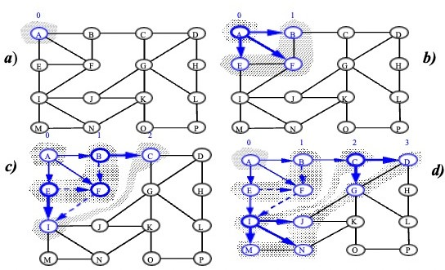
BFS – Graphical Representation

Slide 6
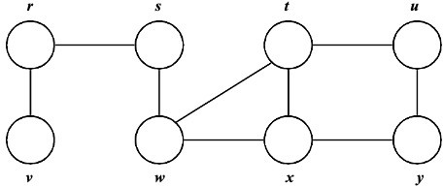
BFS – Example

Slide 7
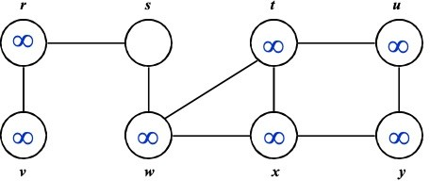
BFS – Example

Slide 8
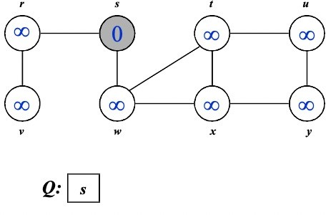
BFS – Example

Slide 9
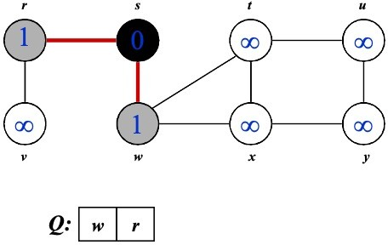
BFS – Example

Slide 10
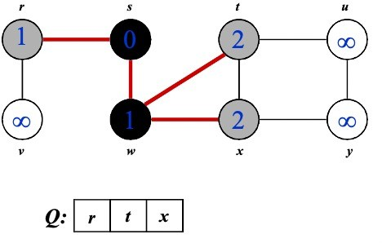
BFS – Example

Slide 11
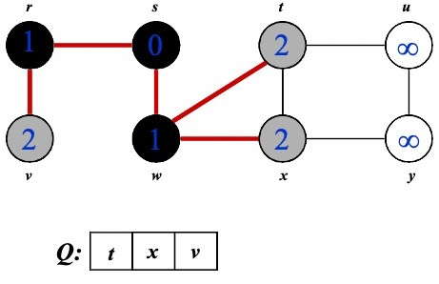
BFS – Example

Slide 12
BFS – Example

Slide 13
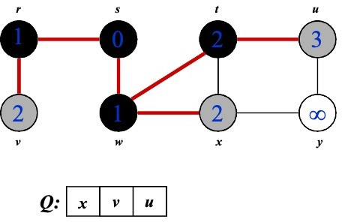
BFS – Example

Slide 14
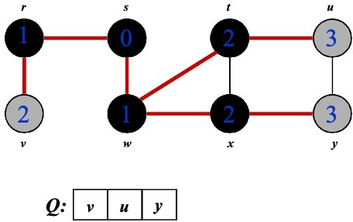
BFS – Example

Slide 15
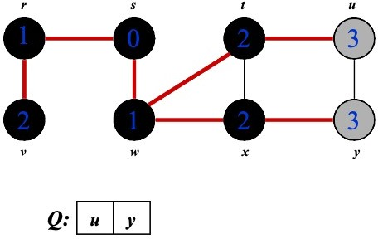
BFS – Example

Slide 16
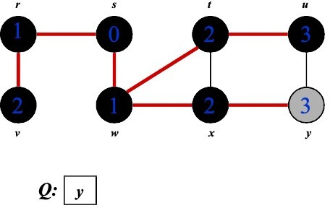
BFS – Example

Slide 17
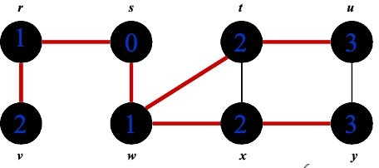

BFS – Example

Slide 18
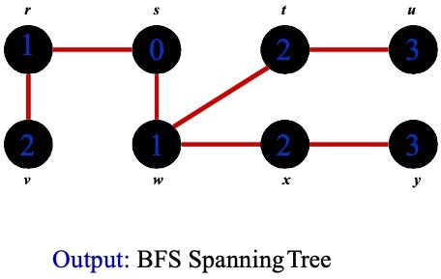
BFS – Example

Slide 19
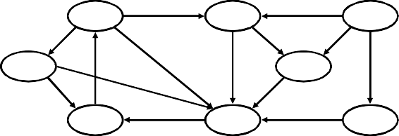
BFS –2
a b c d e
f g h

Slide 20
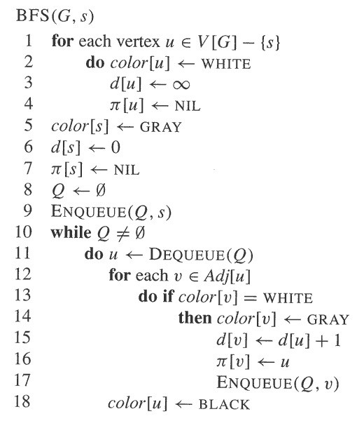
BFS – Code
BFS(G, s) {
initialize vertices;
Q = {s};
while (Q not empty) {
u = RemoveTop(Q);
for each v ∈ u->adj {
if(v->color == WHITE)
v->color = GRAY;
v->d = u->d + 1;
v->p = u;
EnQueue(Q,v);
}
u->color = BLACK;
}

Slide 21
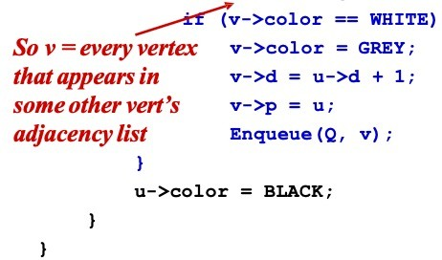
BFS – Code again
BFS(G, s) {
initialize vertices;
Q = {s};
while (Q not empty) { u = RemoveTop(Q);
for each v ∈ u->adj {
Touch every vertex: O(V)
u = every vertex, but only once
(Why?)
What will be the running time?
Total running time:
O(V + Σ(degree(v))) = O(V+E)

Slide 22
BFS – Code again
BFS(G, s) {
initialize vertices;
Q = {s};
while (Q not empty) { u = RemoveTop(Q);
for each v ∈ u->adj {
Touch every vertex: O(V)
u = every vertex, but only once
(Why?)
What will be the storage cost in addition to storing the tree?
Total space used:
O(V + Σ(degree(v))) = O(V + E)

Slide 23
BFS – Properties
BFS calculates the shortest-path distance to the source node
Shortest-path distance δ(s, v) = minimum number of edges from s to v, or ∞ if v not reachable from s
BFS builds breadth-first spanning tree (forest), in which paths to root(s) represent shortest paths in G
Thus can use BFS to calculate shortest path from one vertex to another in O(V + E) time in an unweighted graph

Slide 24
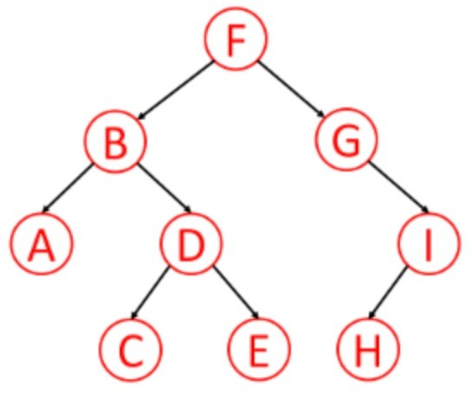
Level Order Traversal – Using Queue
In a level order traversal, every node on a level is visited before going to a lower level
Solution?
Start a BFS traversal from the tree root !!

Slide 25
Thank You

